Slide 1
Fire & Water Safety For Schools

Slide 2
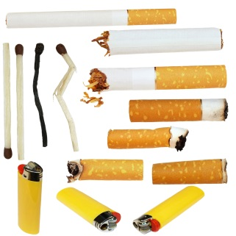
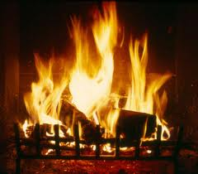
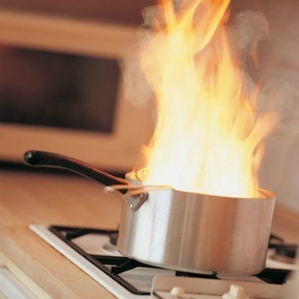
WHAT COULD START A FIRE AT HOME?
The four most common causes of fire in the home are:
Smoking materials
Fires and heaters
Cooking
Electrical items

Slide 3
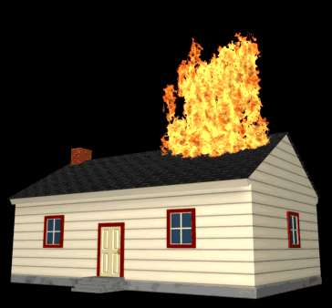
WHAT WOULD WAKE YOU UP…
and warn you there was a fire, especially at night?

Slide 4
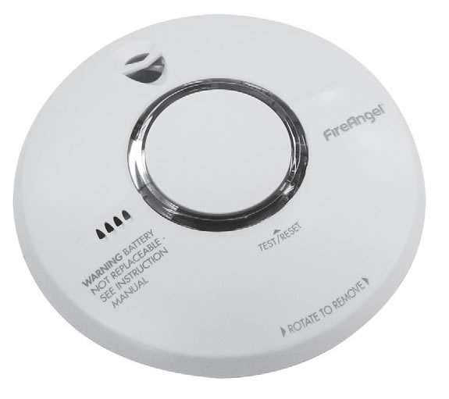
SMOKE ALARMS
How often should they be tested?

Slide 5
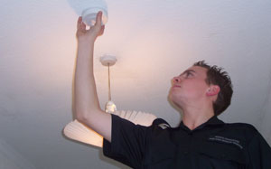
Ask an adult to test them once a Month
Notes:
One smoke alarm on every floor.

Slide 6
FIRE DRILLS
What fire safety do you practice at school?
Why not practice at home as well?

Slide 7
In the event of a fire!
What can stop fire spreading through a house?
Doors
What can wake us up?
A smoke alarm
What should you do before going through a door?
Test them for heat
What should you do when leaving?
Shout to anyone in the house
Crawl to avoid the smoke
Close doors when leaving rooms
GET OUT, STAY OUT, GET THE FIRE BRIGADE OUT!

Slide 8
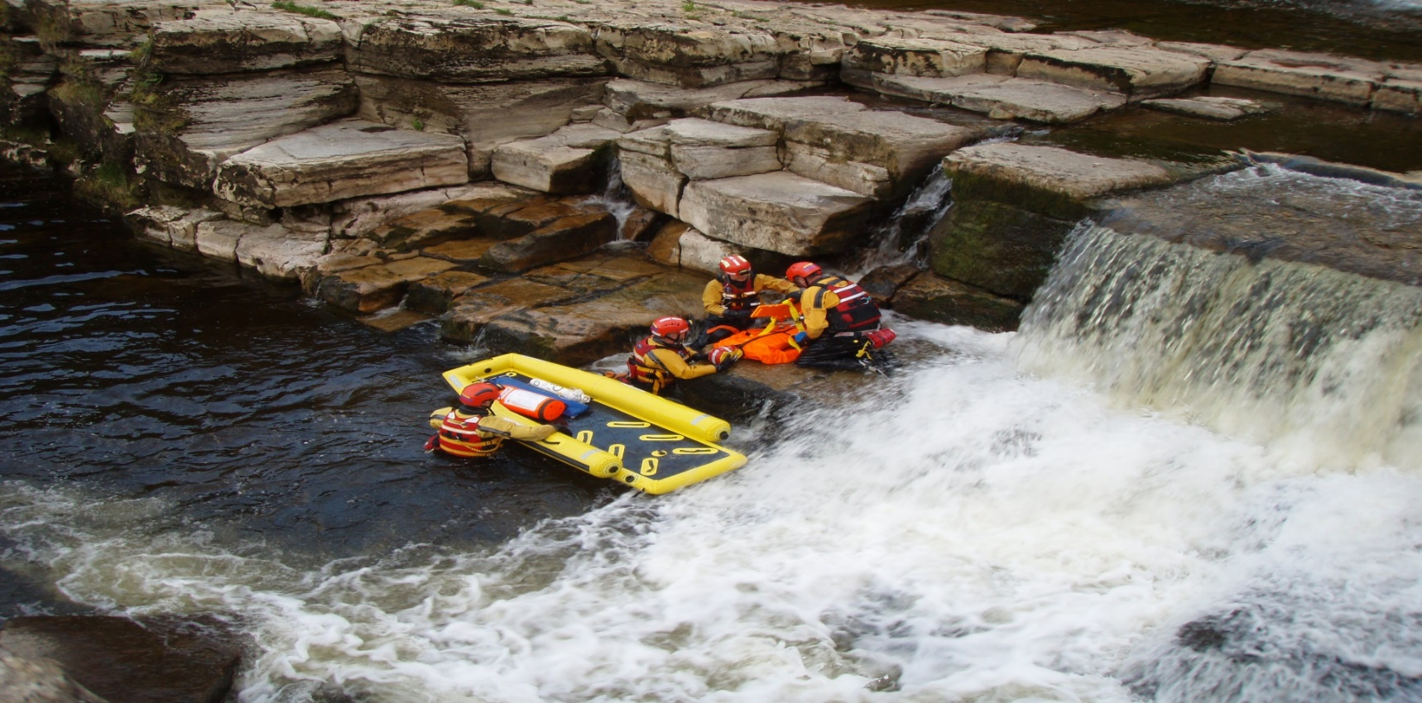
Water Safety
Notes:
Q. How many people die every year as a result of drowning?
A. Over 400?
Compare and contrast the relative risk of fire against water but the fact that we are better prepared for fire events than water events.

Slide 9
Open water…..spot the hazards?
Notes:
Around 85% of accidental drownings occur at open water sites.
Top 5 Open Water Safety Tips:
Be aware of your surroundings and take notice of any warning signs when out and about
When running or walking next to open water, stay well clear of bank edges. They are often unstable and this can create slips, trips and falls
Try to always walk or run with a friend
Always let someone know where you’re going – take your mobile phone
Learn swimming and lifesaving skills

Slide 10
Open water…..spot the hazards?
temperature
disease
depth
current
underwater obstructions
supervision
poor visibility
sharp objects
chemicals
slippery surfaces
vegetation
Notes:
Encourage pupils to discuss each hazard and the differences of swimming in open water compared to in a supervised swimming pool
Temperature; gag reflex, hypothermia, loss of strength.
Underwater obstructions; boulders, discarded sharps, rubbish, vegetation, weirs, currents.
Depth; variable, uneven, unknown.
Current; unseen on surface, strong.
Supervision; nobody looking out for.
Visibility; will not see if somebody goes under.
Slippery surfaces; piers may have moss.
Vegetation; can entrap in water, can slip on bankside.
Chemicals; run off from fields.
Disease; weals etc.

Slide 11
How the Fire Service prepares for open water incidents
Notes:
The kit the Fire Service use and wear when we go into open water to perform rescues.

Slide 12
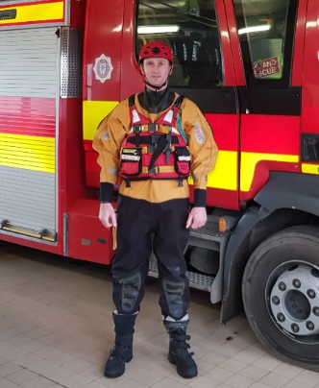
How the Fire Service prepares for open water incidents

Slide 13
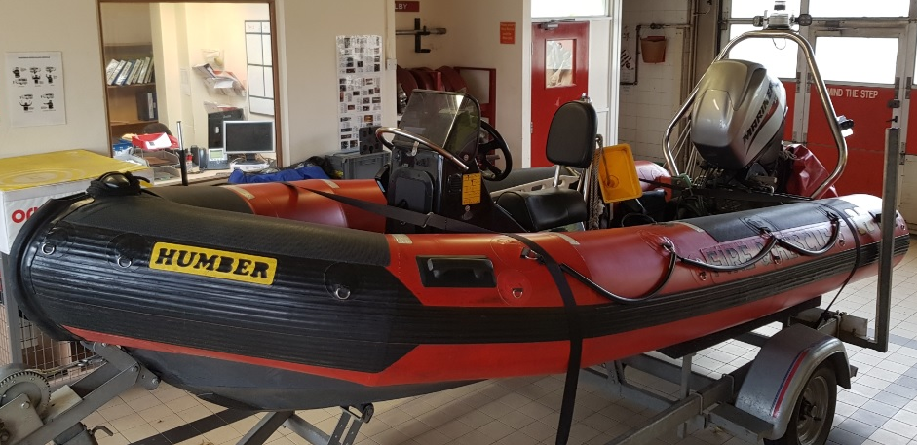
How the Fire Service prepares for open water incidents
Notes:
Fire Service Boat which is used to perform rescues from rivers

Slide 14
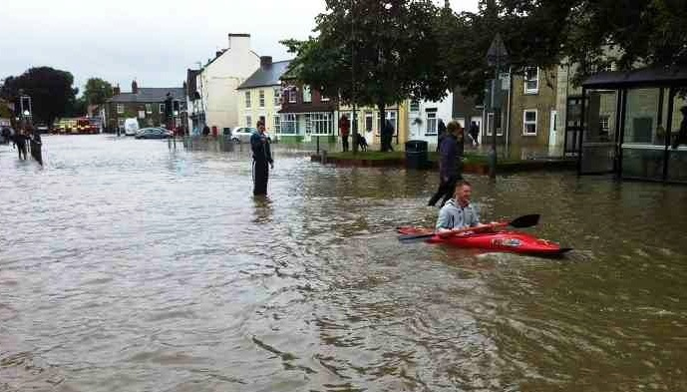
Flooding......what are the extra hazards?
Notes:
Flooding is becoming more frequent. There are numerous reasons for this including natural and man made. For example the need for more housing means housing being built closer to known flood plains and people using more hard landscaping reducing natural drainage increasing pressure on drainage systems. More than 12% of the UK population now live in areas at risk of flooding from rivers or the sea which can cause drowning.
Ask for pupils experience in floods as most will have been directly impacted or will know family or friends who have been.
It can seem exciting, after all, it isn’t every day that you see someone canoeing up the high street (Catterick Village), however....
Whether there are swollen rivers or general floodwater on roads and pathways, it is vital people follow simple, common sense, steps during periods of flooding to help ensure they, and their families, stay safe.
It is often tempting to take a look at rivers at their peak but this can be dangerous, and drivers may take risks driving through floodwater, unaware of levels of depth. It is vital not to underestimate the power of floodwater.

Slide 15
Flooding......what are the extra hazards?
electricity
Sewage
drains
weakened structures
submerged fences
manhole covers
Notes:
Discuss the stupidity of getting into flood water and the extra hazards present;
Electricity; from street furniture etc.
Sewage; from overtopped mains and houses and sceptic tanks etc.
Weakened structures; because of flow and water impregnation e.g. Tadcaster bridge.
Manhole covers; risk of entrapment as pressure can lift from their housing

Slide 16
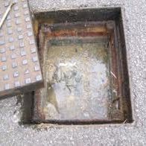
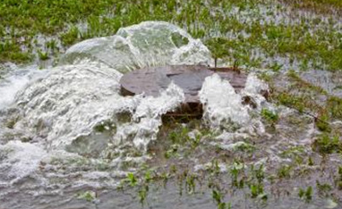
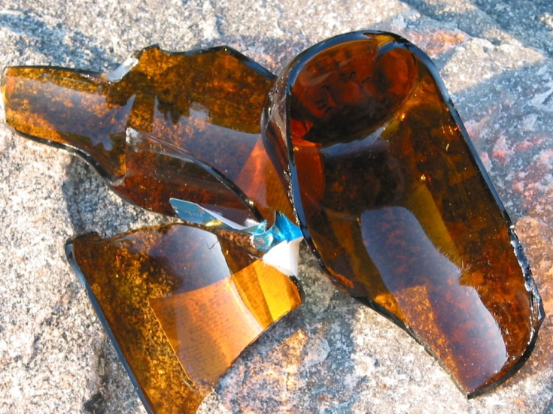
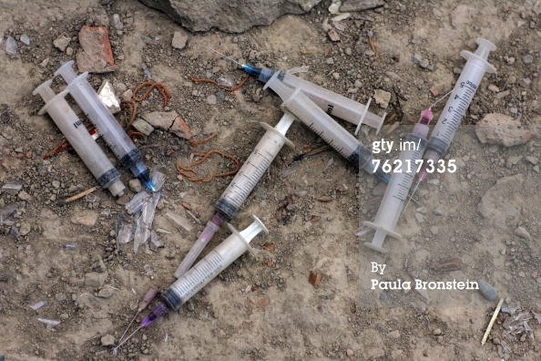
What are you getting in to?
Would you climb into this?
What is getting in to you?
Notes:
This drain contains everything that you have washed, or flushed away from dirty dishwater through to raw sewage. When the systems cannot cope the water mains and sewers overload and the contents enter the flood waters.
It is not just flood waters that contain contaminants, they are also in rivers and streams through natural and unnatural pollution and waste.

Slide 17
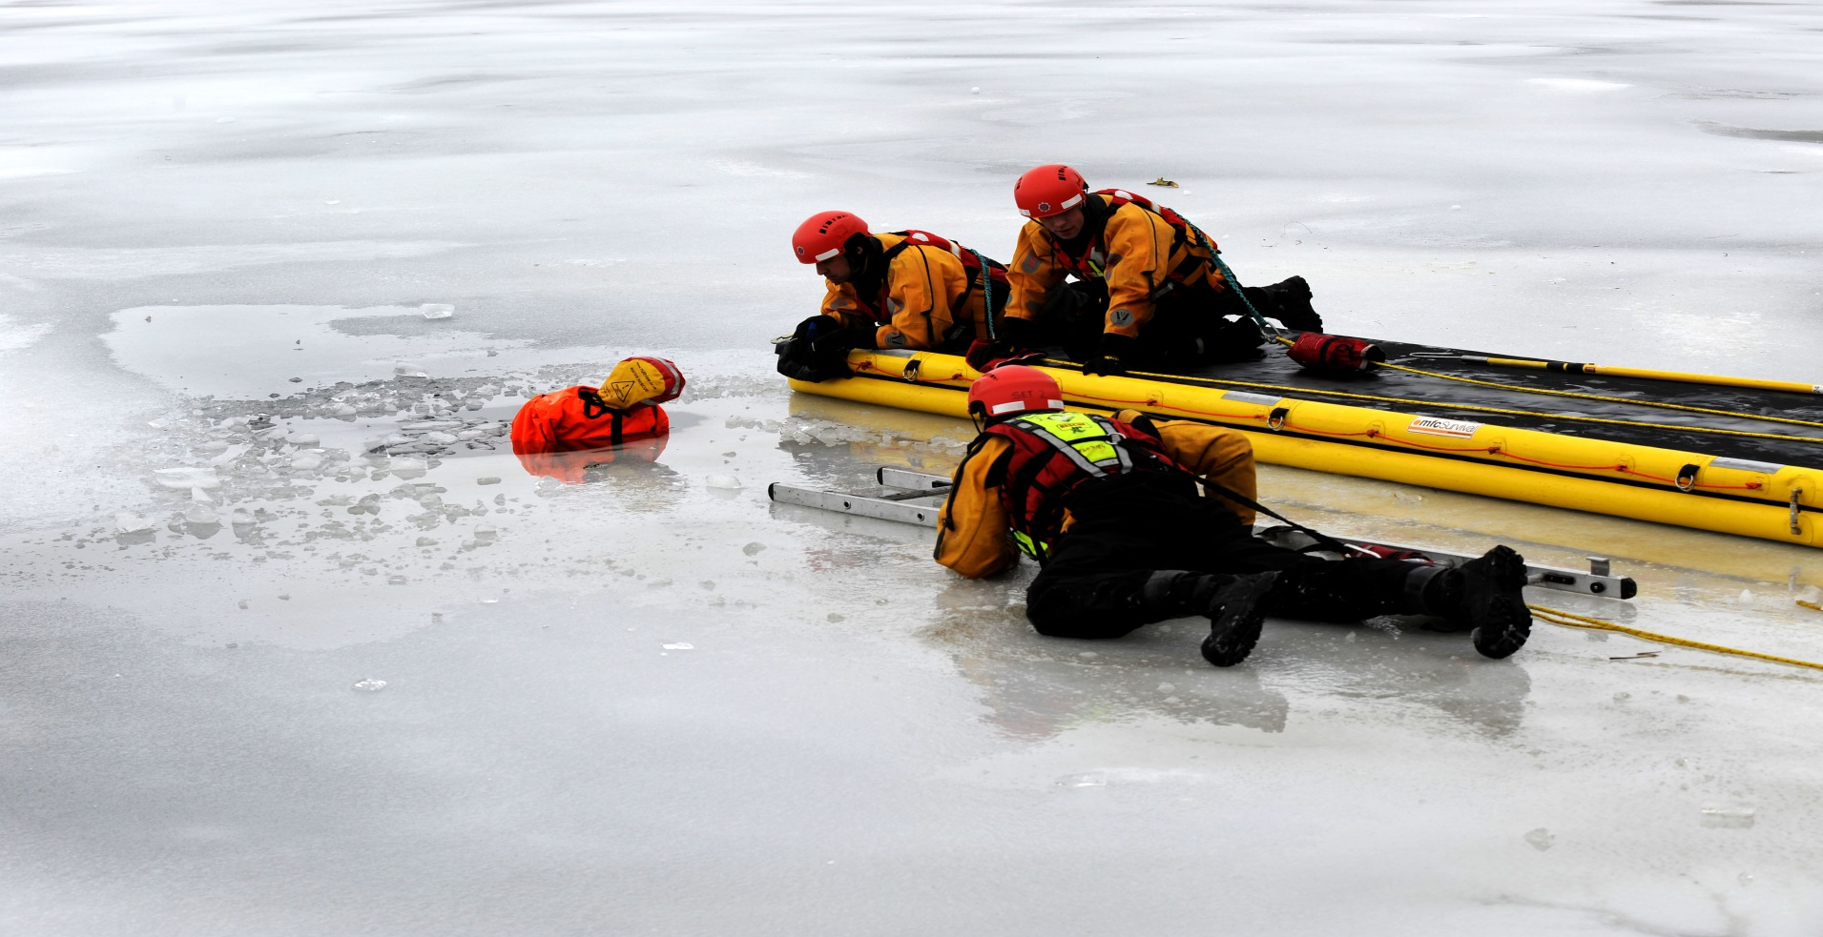
Water looks different in the winter…..
Notes:
Never play on ice….you don’t know the thickness or what is underneath
Never follow pets onto ice….keep them on a lead
Swim fatigue can kill in 25-30 minutes even for strong swimmers
Cold shock can kill in 3-5 minutes
Everybody has initial reactions to sudden cold. If you want to test this, get in the shower, turn it to cold and point it at your naval, you will experience the reactions in a limited way. The more severe the shock, the more severe the reaction.
Gasp reflex: Sharp intake of breath due to the immersion in cold water. If the head goes under, water may be breathed into the lungs during the gasp.
When fresh water is inhaled into the lungs, it passes into the bloodstream through osmosis. When the blood is so radically diluted, cells burst, leading to organ failure. The entire process takes two to three minutes.
A victim encounters “cold shock response” when suddenly submerged in cold water. Cold shock decreases breath hold time and making person panic, leading to breathing difficulties and hyperventilation and potential muscle spasms. Blood pressure will increase with heart rate, combined with adrenaline can lead to arrhythmia or heart attack.
The problem is that due to lack of oxygen you are less coordinated or aware of what your body is doing so most people do not realise that swim failure is occurring and may think they are in a normal swimming position.
It is worth noting that secondary drowning can occur upto 72 hours after near drowning as water absorbed from the stomach distorts the pH balance.

Slide 18
So where should you swim?
Can you identify why this water is safe?

Slide 19
Warm weather?
Life Guard
Easy route out
Other people around
Depth markers
Dry Ground
Clear water/ no entanglements
No water current

Slide 20
On holiday on the beach…..what do the flags mean?
Dangerous to bathe or swim and you should not go into the water
Lifeguards are on patrol. You should only swim or boogie board in the area between the flags
The area is safe for watercraft, like surfboards and kayaks. It is not safe to swim or to use a body board
Notes:
Red Flag; Dangerous to bathe or swim and you should not go into the water.
Red and Yellow Flag; Lifeguards are on patrol. You should only swim or boogie board in the area between the flags
Black and White Quartered Flag; The area is safe for watercraft, like surfboards and kayaks. It is not safe to swim or to use a body board

Slide 21
The Water Safety Code
Spot the dangers
Take safety advice
Go together
Learn how to help
GET OUT, STAY OUT, GET THE FIRE BRIGADE OUT!
Notes:
Spot the dangers – Water may look safe but it can be dangerous. You may swim well in a warm indoor pool, but that does not mean you will be able to swim in cold water
Dangers of water include – very cold temperatures, it can be deep, there may be hidden rubbish, no lifeguards, hidden currents, it is difficult to estimate depth, it can be difficult to get out – steep slimy banks, water pollution may make you ill
Take safety advice – Special flags and notices may warn you of danger. Know what the signs mean and do what they tell you.
Go together – Children should always go with an adult, not by themselves, An adult can point out dangers or help if somone is in trouble
Learn how to help – You may be able to help yourself and others if you know what to do in an emergency. If you see someone in difficulty, tell somebody, preferably a lifeguard if there is one nearby, or go to the nearest telephone, dial 999, ask for the Police or Fire Service at inland water sites and the coastguard at the beach
The message is the same for a fire and water safety…….get out if you are in the water, stay out if you are not and get the fire brigade out.

Slide 22
If you do get in trouble…..don’t fight, FLOAT
Fight your instinct to panic or swim hard
Lean back in the water to keep your airway clear
Push your stomach up and extend arms and legs
Gently fin your hands and feet to help keep you afloat
In 60-90 seconds you will be able to control your breathing
Once you can control your breathing swim to safety if you can, call for help or continue to float until help arrives.

Slide 23
Summary
What are the hazards associated with open water and flooding?
What are the common causes of fire in the home?
What is the water safety code and the fire code?
Different flags you might see on the beach?

